Slide 1
Mobile Application Development The Activity class
Muhammad Ibtisam Gul

Slide 2
Topics
The Activity Class
The Task Backstack
The Activity Lifecycle
Starting Activities
Handling Configuration Changes

Slide 3
The Activity Class
Provides a visual interface for user interaction
Each activity typically supports one focused thing a user can do, such as
Viewing an email message
Showing a login screen
Applications often comprise several activities which works together
But, these activities are loosely bound to each other
Activities often start activities belonging to other apps
Activities must be registered in app’s manifest
Activities lifecycles must be managed appropriately.

Slide 4
Navigation Through Activities
Android supports navigation in several ways:
Tasks
The task backstack
Suspending & resuming activities

Slide 5
Tasks
A Task is a set of related Activities
These related activities don’t have to be part of the same application
Most tasks start at the home screen
SEE: https://developer.android.com/guide/components/activities/tasks-and-back-stack

Slide 6
Task backstack
When an Activity is launched, it goes on top of the backstack
When the Activity is destroyed, it is popped off the backstack

Slide 7
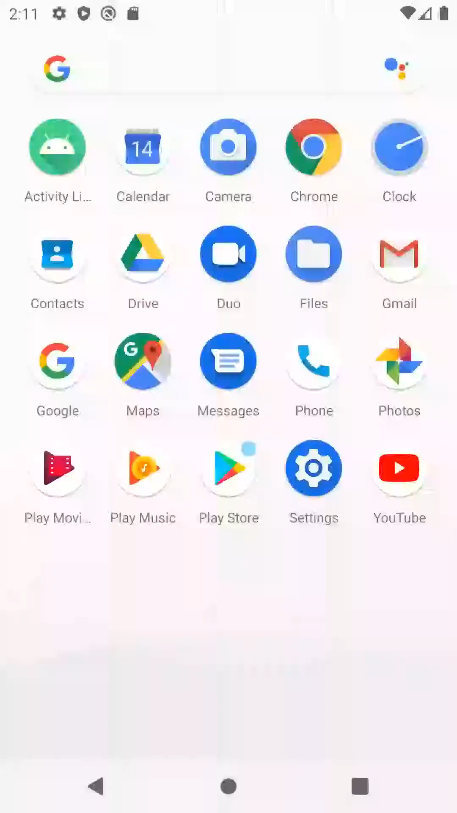
Task Backstack
Third Activity
Second Activity
Main Activity
Task Backstack

Slide 8
The Activity Lifecycle
Activities are created, suspended, resumed & destroyed as necessary when an application executes
Some of these actions depend on user behavior Some depend on Android
e.g., Android can kill activities when it needs their resources
An activity goes through a number of states. You use a series of callbacks to handle transitions between states.
Depending on the complexity of your activity, you probably don't need to implement all the lifecycle methods.

Slide 9
Activity States
Resumed/Running
visible, user interacting
Paused
visible, user not interacting, can be terminated (prior to version 3 android could terminate an activity in paused state)*
Stopped
not visible, can be terminated

Slide 10
The Activity Lifecycle Methods
Android announces activity lifecycle state changes to activity by calling specific activity callback methods
Callback methods:
protected void onCreate (Bundle savedInstanceState)
protected void onStart()
protected void onResume()
protected void onPause()
protected void onRestart()
protected void onStop()
protected void onDestroy()

Slide 11
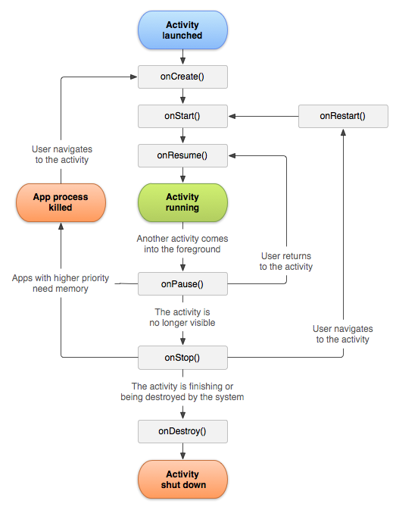
Activity Lifecycle

Slide 12
Visible & In foreground Lifetime
Visible Lifetime
Entire Lifetime

Slide 13
Example
Consult Android Lifecycle Example
https://github.com/Ibtisam/Android-Lifecycle-Example

Slide 14
Example Results (Collaboration)
Main Activity
Second Activity
Third Activity
In Activity 1 OnCreate()
In Activity 1 OnStart()
In Activity 1 OnResume()
In Activity 2 OnCreate()
In Activity 2 OnStart()
In Activity 2 OnResume()
In Activity 3 OnCreate()
In Activity 3 OnStart()
In Activity 3 OnResume()
In Activity 1 OnPause()
In Activity 2 OnPause()
In Activity 3 OnPause()
In Activity 1 OnStop()
In Activity 2 OnStop()
In Activity 3 OnStop()
In Activity 3 OnDestroy()
In Activity 1 OnRestart()
In Activity 1 OnStart()
In Activity 1 OnResume()
In Activity 2 OnRestart()
In Activity 2 OnStart()
In Activity 2 OnResume()
In Activity 1 OnPause()
In Activity 1 OnStop()
In Activity 1 OnDestroy()
In Activity 2 OnPause()
In Activity 2 OnStop()
In Activity 2 OnDestroy()

Slide 15
onCreate()
Called when Activity is created
Sets up Initial state
Call super.onCreate()
Set the Activity’s content view
Retain references to UI views as necessary
Configure views as necessary

Slide 16
onRestart()
Called if the Activity has been stopped and is about to be started again
Typical actions
Special processing needed only after having been stopped

Slide 17
onStart()
Activity is about to become visible
Typical actions
Start when visible-only behaviors
Loading persistent application state

Slide 18
onResume()
Activity is visible and about to start interacting with user
Typical actions
Start foreground-only behaviors

Slide 19
onPause()
Focus about to switch to another Activity
Typical actions
Shutdown foreground-only behaviors
Save persistent state

Slide 20
onStop()
Activity is no longer visible to user
may be restarted later
Typical actions
Cache state
Note: may not be called if Android kills your application

Slide 21
onDestroy()
Activity is about to be destroyed
Typical actions
Release Activity resources
Note: may not be called if Android kills your application

Slide 22
Starting Activities
Create an Intent object specifying the Activity to start
Pass newly created Intent to methods, such as:
startActivity()
startActivityForResult()
Invokes a Callback method when the called Activity finishes to return a result

Slide 23
Getting result from Activity
Started Activity can set its result by calling Activity.setResult()
public ﬁnal void setResult (int resultCode)
public ﬁnal void setResult (int resultCode, Intent data)
Get results using
onActivityResult(int requestCode, int resultCode, Intent data)

Slide 24
Examples
For startActivity example consult
https://github.com/Ibtisam/Simple-Calculator-Using-startActivity
For startActivityForResult example consult
https://github.com/Ibtisam/Simple-Calculator-Using-startActivityForResult

Slide 25
Configuration Changes
Keyboard, orientation, locale, etc.
Device configuration can change at runtime
On configuration changes, Android usually kills the current Activity & then restarts it
Activity restarting should be fast If necessary you can:
Retain an Object containing important state information during a configuration change
Manually handle the configuration change

Slide 26
Retaining an object
Hard to re-compute data can be cached to speed up handling of configuration changes
Override onSaveInstanceState(Bundle savedInstanceState) to build & return configuration Object
Will be called by the system before onStop()
Override onRestoreInstanceState(Bundle savedInstanceState) to recover data.
It will be called by the system after onStart()

Slide 27
Manual Reconfiguration
Can prevent system from restarting Activity
Declare the configuration changes your Activity handles in AndroidManifest.xml file,
e.g.,
<activity android:name=".MainActivity“
android:configChanges="orientation|screenSize“
android:label="@string/app_name">
When configuration changes,
Activity’ s onConﬁgurationChanged() method is called
Passed a Configuration object specifying the new device configuration

Slide 28
Examples
Auto Configuration Change example
https://github.com/Ibtisam/Auto-Configuration-Change-Example
Saving the state
https://github.com/Ibtisam/Save-State-Example
Manual Configuration Change Example
https://github.com/Ibtisam/Manual-Configuration-Change-Example

Slide 29
References
https://developer.android.com/guide/components/activities/intro-activities
https://developer.android.com/guide/components/activities/tasks-and-back-stack
https://developer.android.com/guide/components/activities/activity-lifecycle

